Slide 1
16th session.
Short and Long Term Classical Financial Instruments
Notes:
We will deal with financial topics slowly because, finally, we have to use numbers for things.

Slide 2
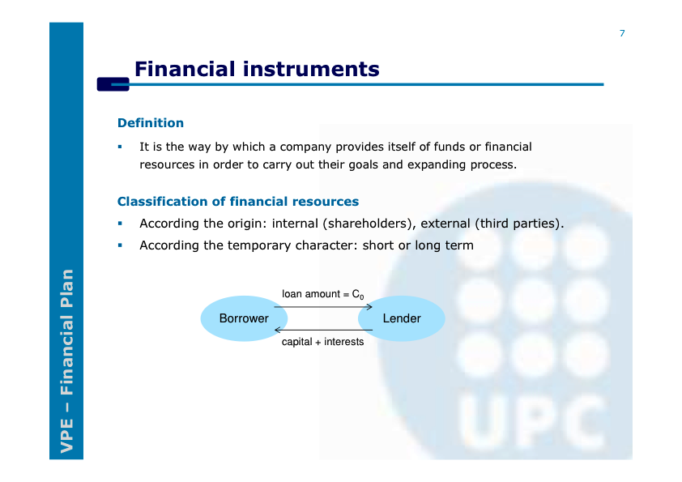

Slide 3
The balance sheet and the financial instruments
Assets
Liabilities
and equity
Initial investment
Capital increase
Reserves
Fixed
Assets
Equity
New partners
Long term loan
Guaranteed Long term loan
Long-term
liabilities
Leasing
“Renting”
Current
Assets
Suppliers financing
Current
liabilities
Tax office financing
Short term loan
Bill Discount
Overdraft
Factoring - Confirming
Notes:
Spend much time in this slide and explain the initial balance of Bar Pepe S.L.

Slide 4
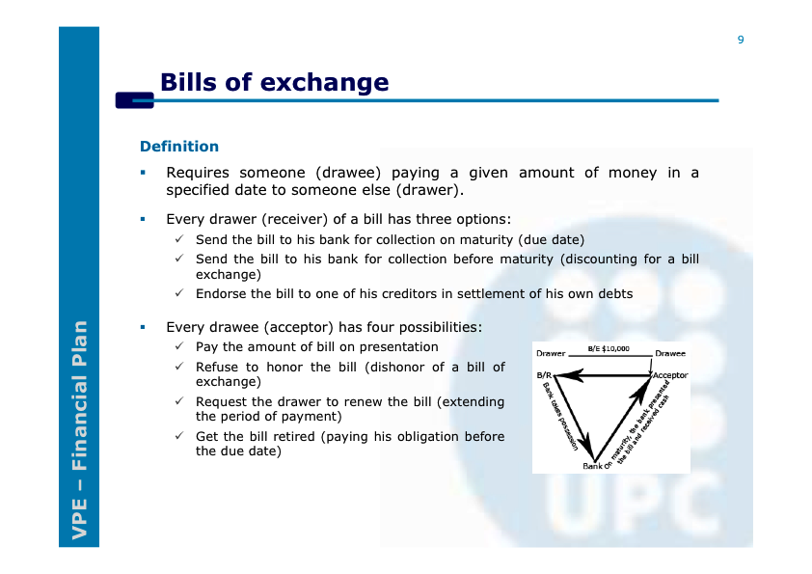

Slide 5
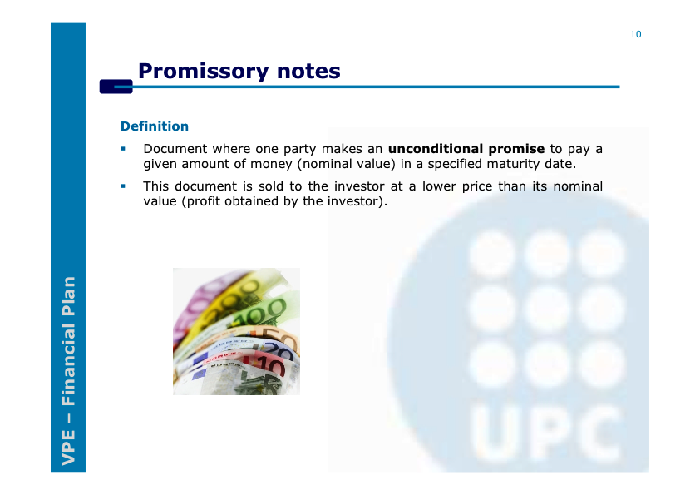

Slide 6
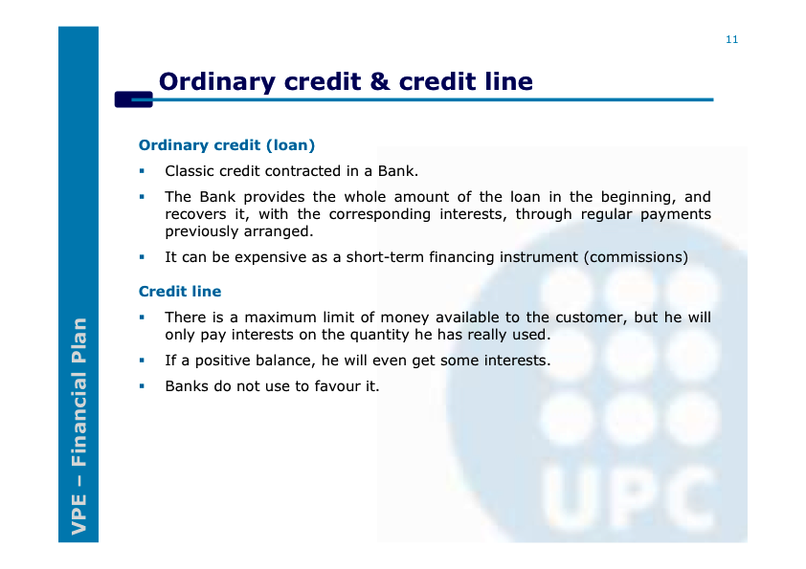
(Overdraft)

Slide 7
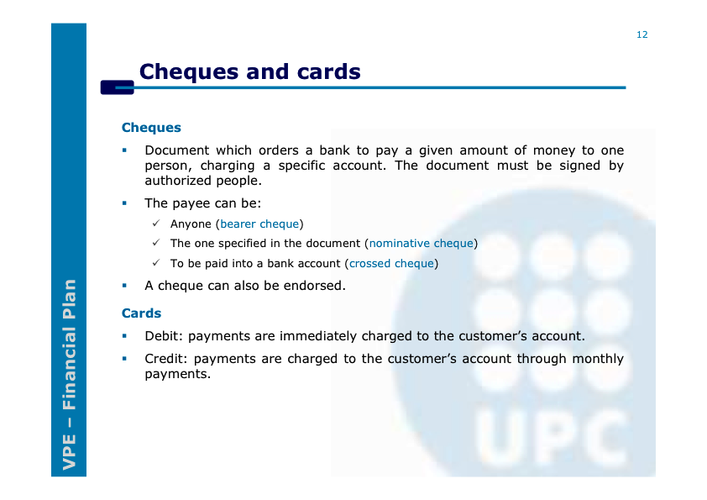

Slide 8
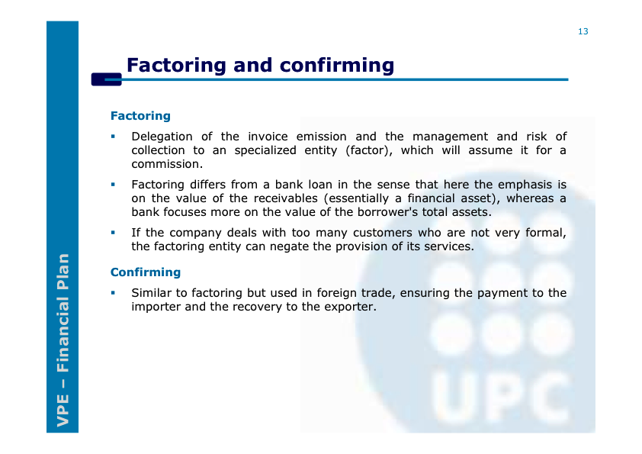

Slide 9
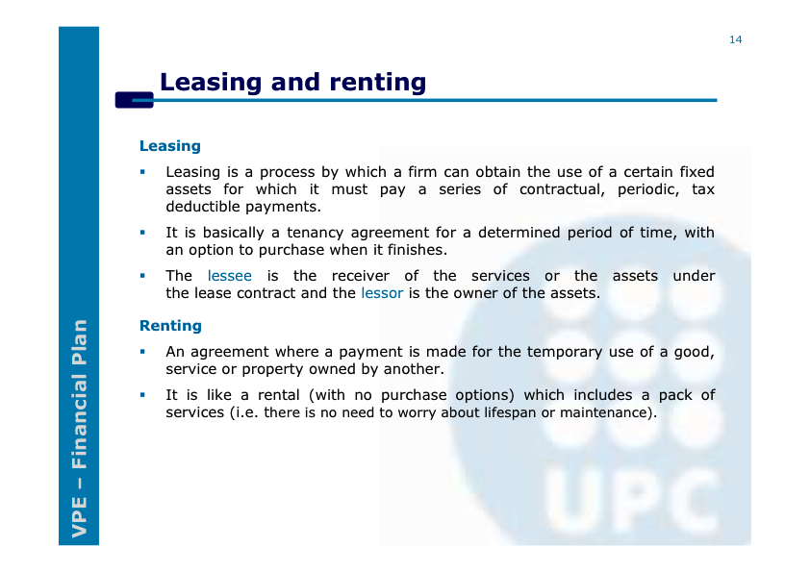

Slide 10
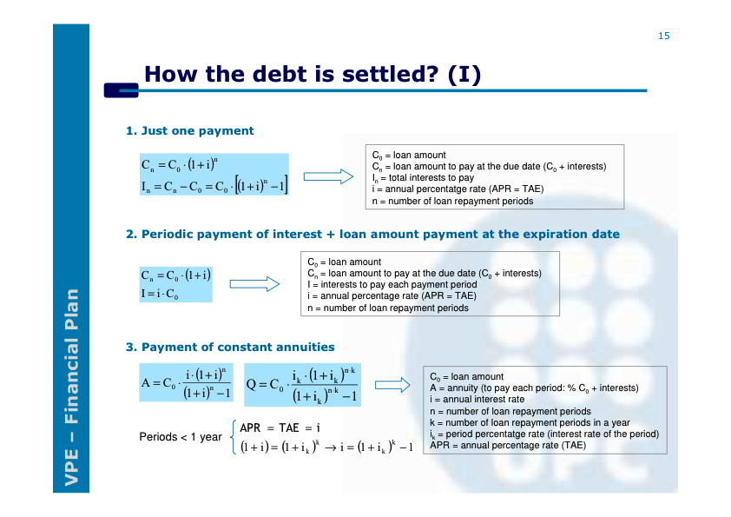

Slide 11
